Slide 1
Lecture 12
Graphs

Slide 2
Main Points
Introduction to graphs
  Terms
Type of graphs
Representing a graph in a program
  Adjacency Matrix
  Adjacency List
Searching a graph
  DFS
  BFS
Minimum Spanning Tree
Shortest Path

Slide 3
Introduction to Graphs
Graphs are one of the most versatile structures used in computer programming
The sort of problems that graphs can help to solve are quit different from the ones we solved so far
  For some problems, graphs are indispensable
Discuss previous data structures architectures
Graphs have a shape dictated by a physical problem
  Example of cities and routes
  Project tasks

Slide 4
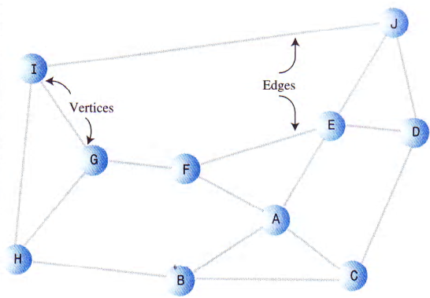
Introduction to graphs: G=(V, E)

Slide 5
Definitions
Two vertices are said to be adjacent to another if they are connected by a single edge
  I & G are adjacent
  I & F are not
A path is a sequence of edges
  There can be more than one path between two vertices
    To go from B to J: BAEJ or BCDJ

Slide 6
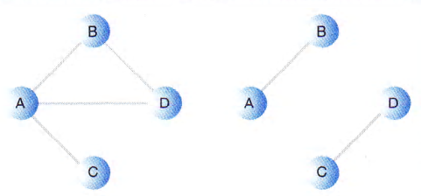
Definitions
Connected Graphs are graphs where there is at least
one path from
every vertex to
every other vertex
The graphs above are non-directed ones
  The edge don’t have a direction
  You can go from A to B or B to A with equal ease
  Graphs are often used to model situations in which you can go in only one direction along an edge: one way street

Slide 7
Definitions
In some graphs, edges are given a weight, a number that can represent the physical distance between two vertices, or the time it takes to get from one vertex to another, or how much it cost to go from vertex to vertex: weighted graphs
Adjacency Set: Given an ‘Edge’ <s,d>, d is adjacent to s. The set of all nodes adjacent to s is called the ‘Adjacency Set’ of s
In-Degree/Out-Degree of a vertex: The number of edges entering/leaving a node
Connected Graphs: for every 2 vertices there exist at least one path
Cycle: a path such as the destination of the last edge is the source of the first edge
  A self-loop is a cycle of length 1
Acyclic graphs: graphs with no cycles. Exp: Trees

Slide 8
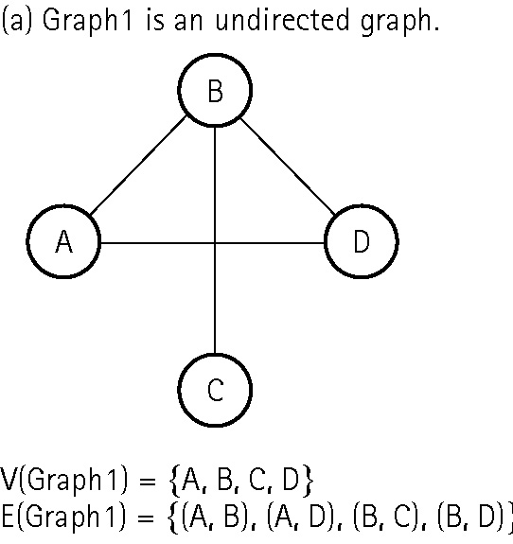
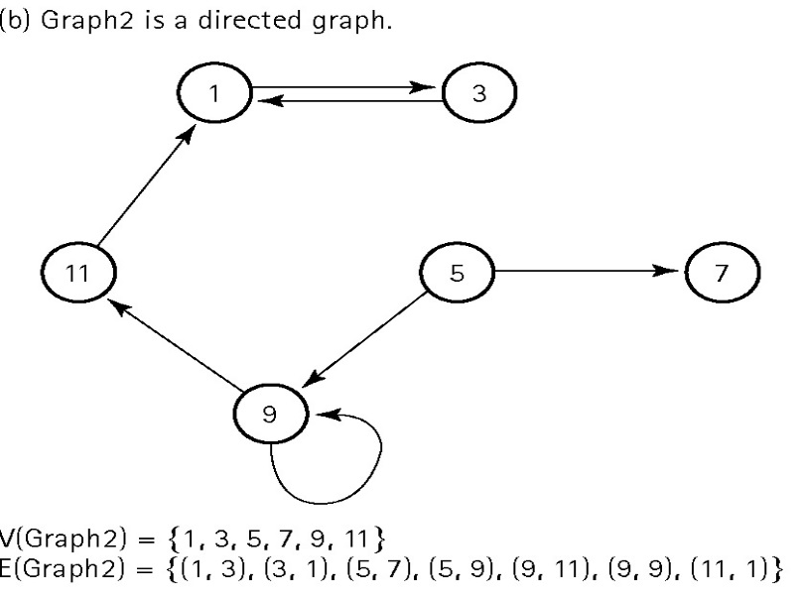
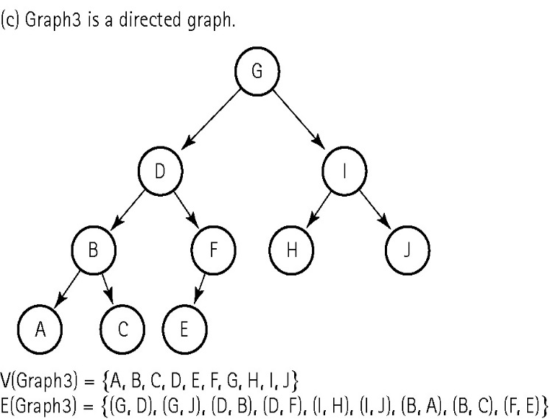
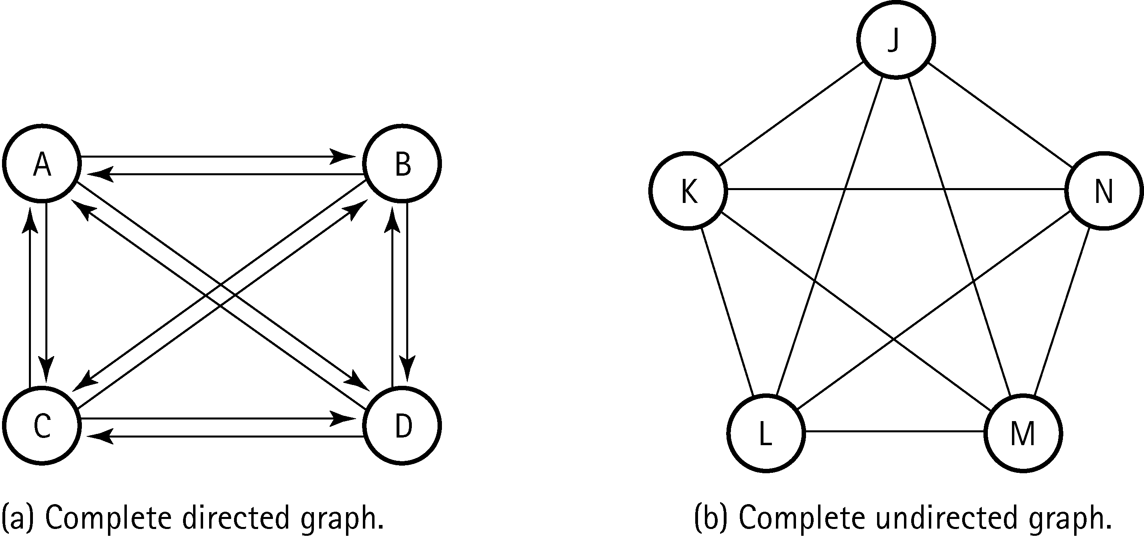
Graphs:

Slide 9
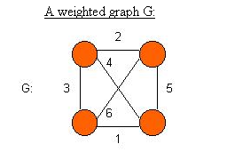
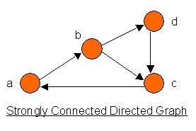
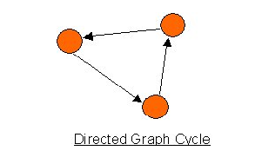
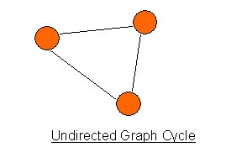
Graphs:

Slide 10
Representing a graph in a program
Historical Note:
One of the first mathematicians to work with graphs
was Leonhard Euler in the early 18th century: 1736.
He solved a famous problem dealing with
the bridges in the town of Konigsberg, Poland
  Refer to the next slide
Euler discovered that the people of ‘Koenigsberg’ cannot do it!
His solution applies to all graphs! – Graph Theory!
Defining the ‘In-Degree’ of a ‘Vertex’ as the number of edges entering it, he proved that such a walk -‘Eulerian Walk’ - can be done only if the ‘In-Degree’ for all vertices is Even!

Slide 11
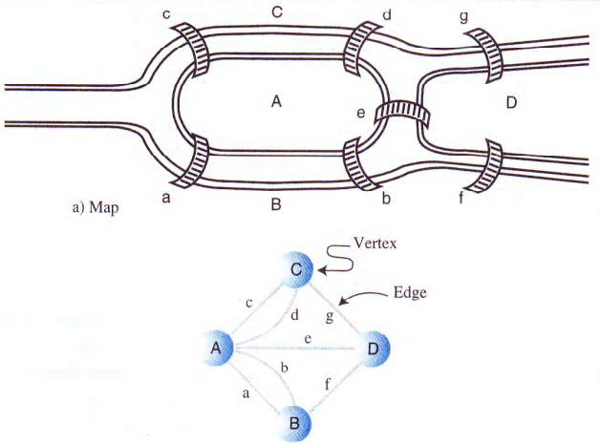

Slide 12
Graph as an ADT

Slide 13
Graphs: an implementation
Vertices:
  In most situations, a vertex represent a real world object, and the object must be described using data items: we can use a structure for that
Edges:
  Trees? Arrays?
  Fixed vs free form organization
Two methods are commonly used for graphs :
  Adjacency matrix and the adjacency list
    Remember: one vertex is said to be adjacent to another if they are connected by a single edge

Slide 14
Graphs: implementation
Basically:
  addVertex(vertex v)
  addEdge(vertex start, vertex end)
  getPath(vertex v1, vertex v2)
  traverseGraph(vertex v)
  getAdjacent(v)
  isConnected(v1, v2)

Slide 15
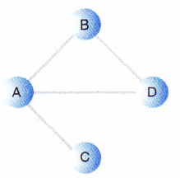
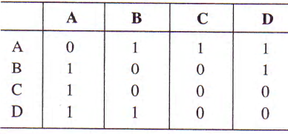
Adjacency Matrix
Two dimensional array
Elements indicate whether an edge is present between two vertices or not
If the graph has N vertices, the matrix will be an N*N array

Slide 16
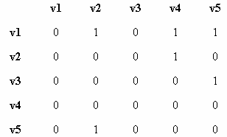
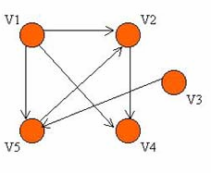
Adjacency Matrix
What will be the adjacency matrix of the following graph?
In a Digraph, the row sum is the ‘Out-Degree’, and the column sum is the ‘In-Degree’
In an Undirected graph, the ‘Degree’ of a vertex is the row sum
In a ‘Weighted Graphs’, the bits (0/1) are replaced by the corresponding ‘Costs’!

Slide 17
Adjacency Matrix: Efficiency
Suppose we want to answer the following 2 questions:
  How many edges are there?
  Is G connected?
All algorithms that answer these questions require O(n²)! – Examining (n² – n) entries of the matrix. The diagonal is always NULL
‘Sparse graphs’!! – Many 0s, few 1s
 Another presentation: The Adjacency List

Slide 18
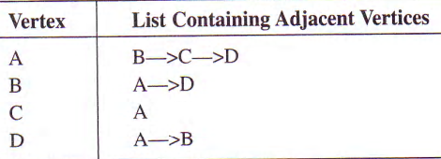
Adjacency List
We refer to linked list
Actually an adjacency list is an array of lists
  Each individual list shows what vertices a given vertex is adjacent to
  Each array element A[i], represents one vertex and points to a linked list of its ‘Adjacent Vertices’

Slide 19
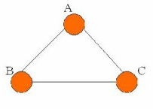
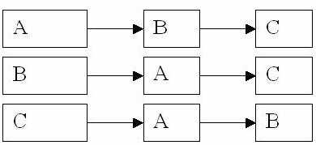
Adjacency List: Cont…
What will be the adjacency list of the following graph?

Slide 20
Adjacency List: Space and Time Complexity
Consider: n=number of vertices, e=number of edges
Space Complexity:
  Undirected graphs  n head pointers + 2e list nodes
  Directed Graphs  n + e
Traversal Time Complexity:
  Directed graphs  O(n + e) = O(n) << O(n²)
  Un-directed graphs  O(n + 2e) = O(n) << O(n²)

Slide 21
Traversing a Graph

Slide 22
Searching a graph
Like trees, there are traversals. BUT, unlike trees, there is no Root!
First  Fix a ‘Starting Node’
Traversal is the most important operation as it solves many questions!
  Given any vertex V, we want to ‘Visit’ all accessible nodes. Hence, we can answer:
    Can I get from a vertex to another? ‘How’?
    Is a graph connected? ‘How’?
    What is the best road? ‘How? Shortest Path - Dijkstra?’…
2 common methods:
  DFS – Depth First Search using a stack
  BFS – Breadth First Search using a queue

Slide 23
DFS: Depth First Search
To carry out the depth first search, you pick a starting point; then do three things: visit the vertex, push it to the stack and mark it so that you won’t visit it again. Follow then the following rules:
  Rule 1: If possible, visit an adjacent unvisited vertex, mark it, and push in the stack
  Rule 2: If you can’t follow rule 1, then, if possible, pop a vertex off the stack
  Rule 3: if you can’t follow rule 1 or rule 2, you are finished

Slide 24
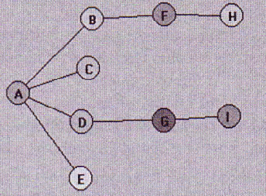
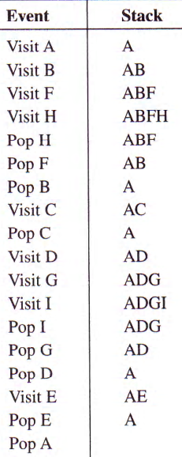
DFS:
Apply the DFS rules and show the content of the stack after traversing the following graph:

Slide 25
Breadth First Search: BFS
In DFS, the algorithm acts as though it wants to get as far away from the starting point as quickly as possible.
In BFS, the algorithm likes to stay as close as possible to starting point. It visits all vertices adjacent to the starting vertex, and only goes further a field. This kind of search is implemented using a queue instead of a stack.

Slide 26
BFS: Rules to respect
Pick up a starting vertex, visit it, mark it, and make it the current vertex. After that follow the following rules:
Rule 1: Visit the next unvisited vertex (if there is one) that’s adjacent to the current vertex, mark it, and insert it to the queue
Rule 2: If you can not carry out rule 1 because there are no more unvisited vertices, remove a vertex from the queue (if possible) and make it the current vertex
Rule 3: If you can not carry rule 2 because the queue is empty then you are done!

Slide 27
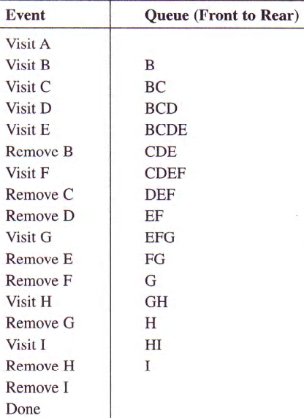
BFS
Apply the BFS rules and show the content of the queue after traversing the following graph:

Slide 28
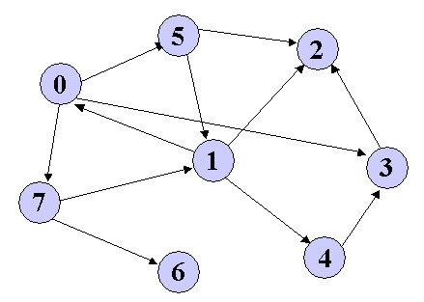
Apply DFS then BFS algorithm

Slide 29
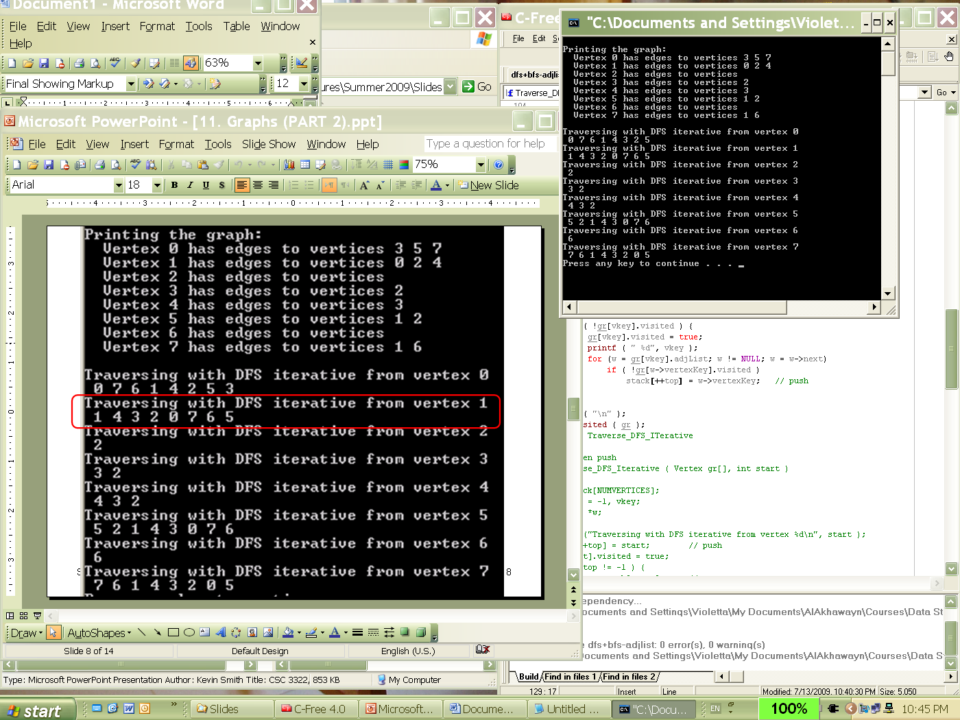
DFS Output
What will be the output if we start by: 0, 1, 2, 3, 4, 5 , 6 ,7 consecutively

Slide 30
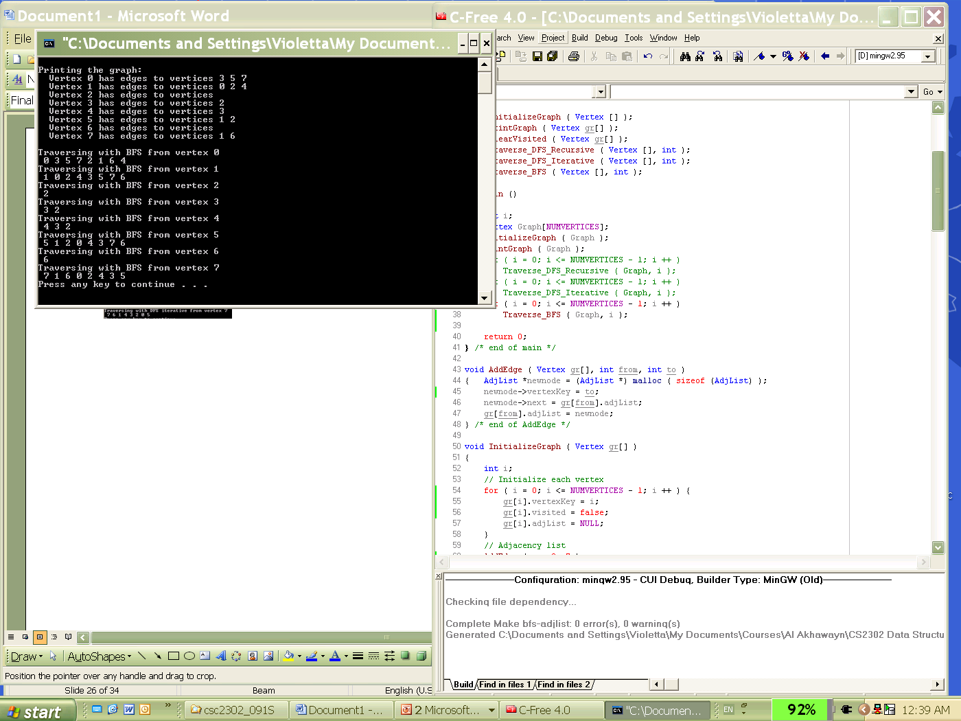
BFS Output

Slide 31
Spanning Tree

Slide 32
Spanning Trees
Both BFS & DFS traverse all vertices in a connected graph, BUT they do not necessarily traverse all edges!
Need for a Sub-graph connecting all vertices
More closely:
  At any moment during a traversal, the edges of the graph are belonging to one of 2 distinct sets:
    S – already visited edges
    B – unvisited edges
  Through a traversal, the algorithm (bfs, dfs) moves edges from B to S
  However, at the end of the traversal, not all edges are visited: B may not be empty!
  Hence, S contains only minimally required edges to visit all vertices!
  The edges in S from a Tree  a Spanning Tree

Slide 33
Spanning Trees (Cont..)
A Graph may have more than one spanning tree
A spanning tree for a graph G(V, E) is a sub-graph of G that forms a tree connecting all G vertices
The number of edges in a Spanning Tree is (n-1), where n is the number of vertices
Adapting ‘BFS’ and ‘DFS’ to generate a spannig tree:
  Add a statement that stores all traversed edges:
    DFS spanning trees OR BFS spanning trees
Exmaple1: Broadcasting in a network – assuring a set of paths to ensure sending messages to all vertices.
Example2: Building a map connecting all cities with a minimum number of roads

Slide 34
Spanning Trees (Examples)
c
b
h
d
A Spanning Tree
f
i
e
a
g
DFS Spanning Tree
BFS Spanning Tree
c
c
h
b
h
b
d
d
f
f
i
e
i
e
a
g
a
g

Slide 35
Weighted Graphs
Minimum Spanning Trees
Important!
Defining the weight of a spanning tree as the sum of the weights of its edges, the MST is the one with least weight.
Use: in the case of ‘Broadcasting’, the MST would correspond to the broadcast with minimal cost. For the roads examples, the MST would correspond to the Road map with least total distance
Constructing an MST  Prim’s Algorithm
  It is an algorithm that finds a minimum spanning tree for a connected weighted undirected graph. This means it finds a subset of the edges that forms a tree that includes every vertex, where the total weight of all the edges in the tree is minimized.

Slide 36
Prim’s Algorithm
Refer to the following link:
  http://www.youtube.com/watch?v=BtGuZ-rrUeY

Slide 37
Prim’s Algorithm
Starts with a tree T containing a single vertex
After each iteration, it adds the edge with minimum weight (Without forming a cycle) to form another intermediate tree
To avoid cycles, at each step we choose the added edge (u, v) such as exactly one of u or v is in T
Iteration stops when having (n-1) edges

Slide 38
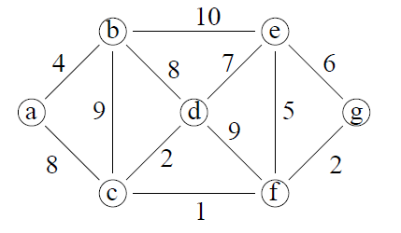
Exercise: Find the MST for the following graph: start by the vertex A

Slide 39
Refer to this video
Refer to this link to understand the matrix used in Prim’s algorithm
https://www.youtube.com/watch?v=Pn874kEc3IA

Slide 40
Shortest Path
Another common problem associated with weighted graphs
Finding the path with minimal weight connecting 2 vertices
Example: Finding the shortest path for routing data in a network between two PCs
Dijkstra - famous Dutch Computer Scientist and mathematician - Algorithm:
  Quite similar to Prim’s algorithm in that it maintains also a solution set S which contains all the vertices examined so far whose minimal distance to the source has been determined. As the algorithm progresses and examines more and more vertices, this set grows and distances are adjusted.
  At each stage the algorithm selects the vertex with least distance
  Unlike Prim’s algorithm, Dijkstra alg. stores the total cost instead of Min

Slide 41
Shortest Path
Dijkstra Algorithm
We need to keep track of three things:
  The lowest total path weight, from the start point to each vertex
  The immediate predecessor in that path of each vertex
  The content of the priority queue

Slide 42
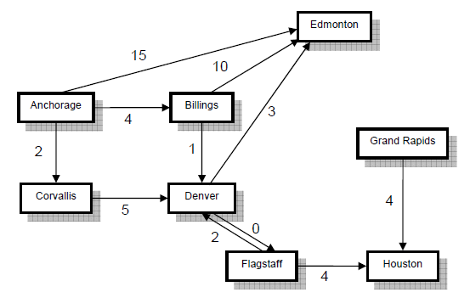
Apply Dijkstra Algorithm to find the shortest path from Anchorage to Edmonton

Slide 43
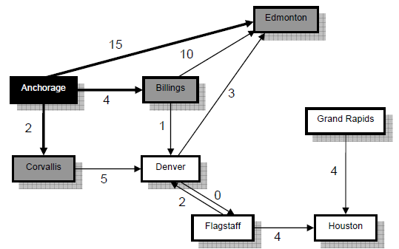
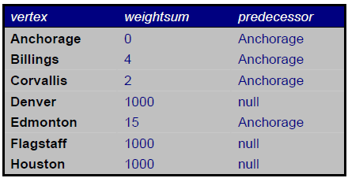
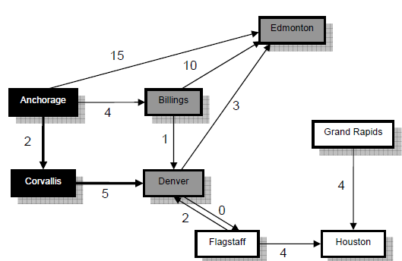
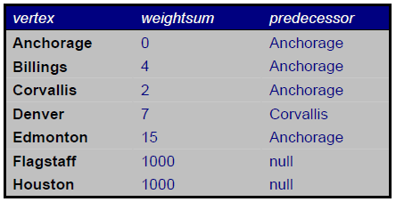
Solution
Priority Queue: Corvallis,2; Billings,4; Edmonton,15 Dequeue Coravallis
Priority Queue: Billings,4; Denver,7; Edmonton15 Dequeue Billings

Slide 44
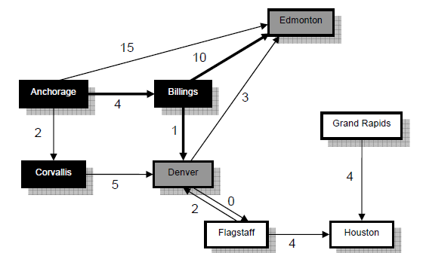
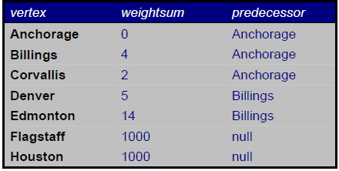
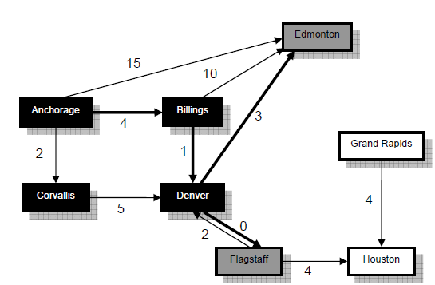
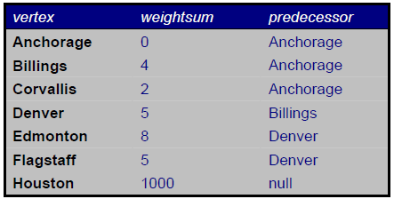
Priority Queue: Denver,5; Denver,7; Edmonton,14; Edmonton,15 Dequeue Denver
Priority Queue: flagstaff,5; Denver,7; Edmonton,8; Edmonton,14, Edmonton,15 Dequeue flagstaff

Slide 45
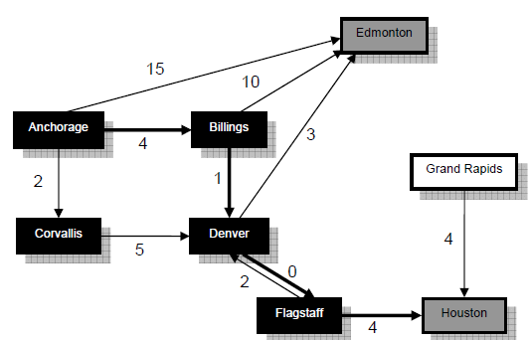
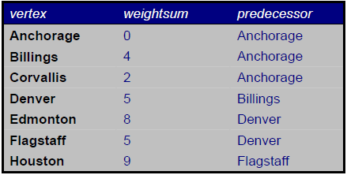
Priority Queue: Denver,7; Edmonton,8; Houston,9; Edmonton,14; Edmonton,15 Dequeue Denever
 No Changes to table as Denver was already visited
Priority Queue: Edmonton,8; Houston,9; Edmonton,14; Edmonton,15 Dequeue Edmonton
Done! We removed a path with weightsum 8 to target. We need to trace the path: predecessor of Edmonton is Denver, predecessor of Denver is Billings, and the predecessor of Billings is Anchorage
Shortest path is Anchorage -> Billings -> Denever -> Edmonton

